Slide 1
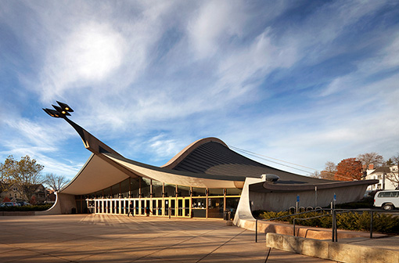
Building name
Location
Building Occupant
Architect
Total gsf
Total Levels
David S. Ingalls Rink
New Haven, CT
Yale University
Eero Saarinen
61,646 sf
2
Client
Architect
Lighting Consultant
Structure Engineers
Mechanical Consultants
Construction Manager
Civil Engineer
Sound System
Yale University
Kevin Roche John Dinkeloo and Associates LLC
Atelier Ten Consulting Designers
Severud Associates Consulting Engineers, P.C.
AltieriSeborWieber LLC
Turner Construction Company
Tighe & Bond
Cavanaugh Tocci Associates, Incorporated
David S. Ingalls Rink
73 Sachem Street, New Haven, CT 06501
Amy Huan | Lighting + Electrical |Final Thesis Presentation | 4/14/2014

Slide 2
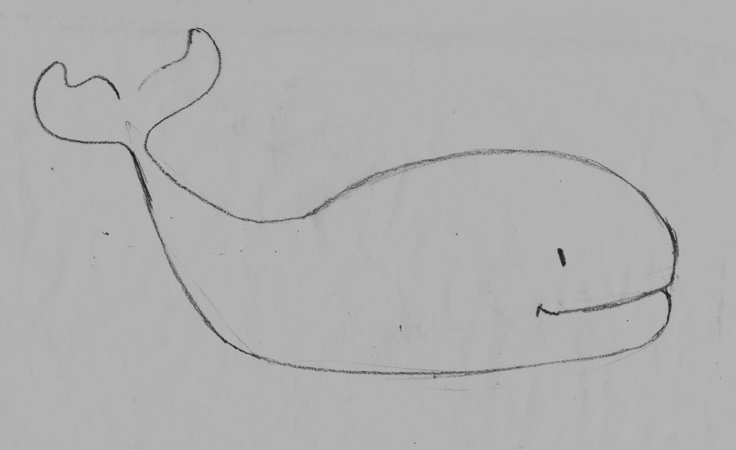
Project Overview
Scope + concept
LG | Building Exterior
Diving
LG | Circulation Corridor
Coral Reef
LG | Rink
Ocean
EL | branch circuit analysis
EL | copper vs. aluminum cost analysis
Acoustic | reverberation time analysis
Thanks to…

Slide 3
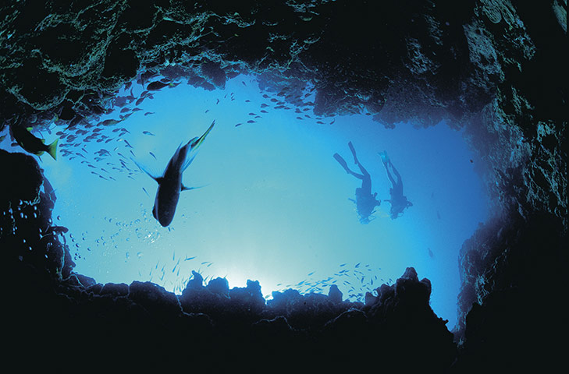
Project Overview
Scope + concept
LG | Building Exterior
Diving
LG | Circulation Corridor
Coral Reef
LG | Rink
Ocean
EL | branch circuit analysis
EL | copper vs. aluminum cost analysis
Acoustic | reverberation time analysis
Thanks to…
Seeing
|Lighting Depth
Building Exterior
Circulation
Rink
Schley Club Room
|Electrical Depth
Branch Circuit Analysis
Short Circuit Analysis
Copper vs. Aluminum Wire Cost Analysis
|Structural Breadth
Wind Load Analysis on Building Entrance
|Acoustical Breadth
Reverberation Time Analysis
|Lighting Depth
Building Exterior
Circulation
Rink
Schley Club Room
|Electrical Depth
Branch Circuit Analysis
Short Circuit Analysis
Copper vs. Aluminum Wire Cost Analysis
|Structural Breadth
Wind Load Analysis on Building Entrance
|Acoustical Breadth
Reverberation Time Analysis
Habitation
Feeling
Hearing

Slide 4
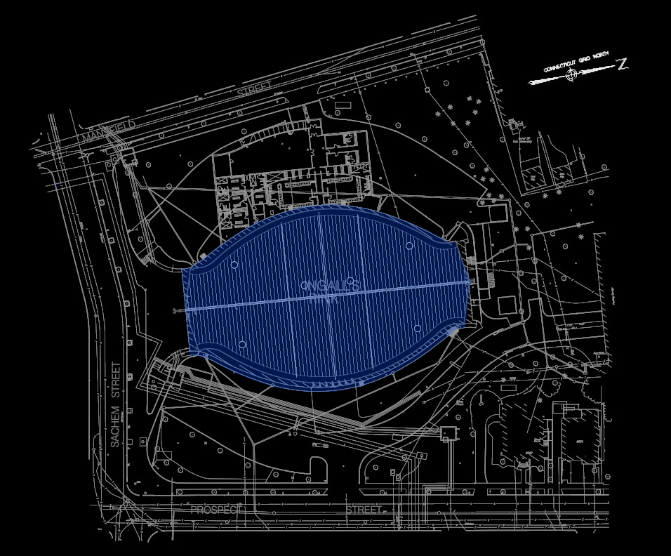
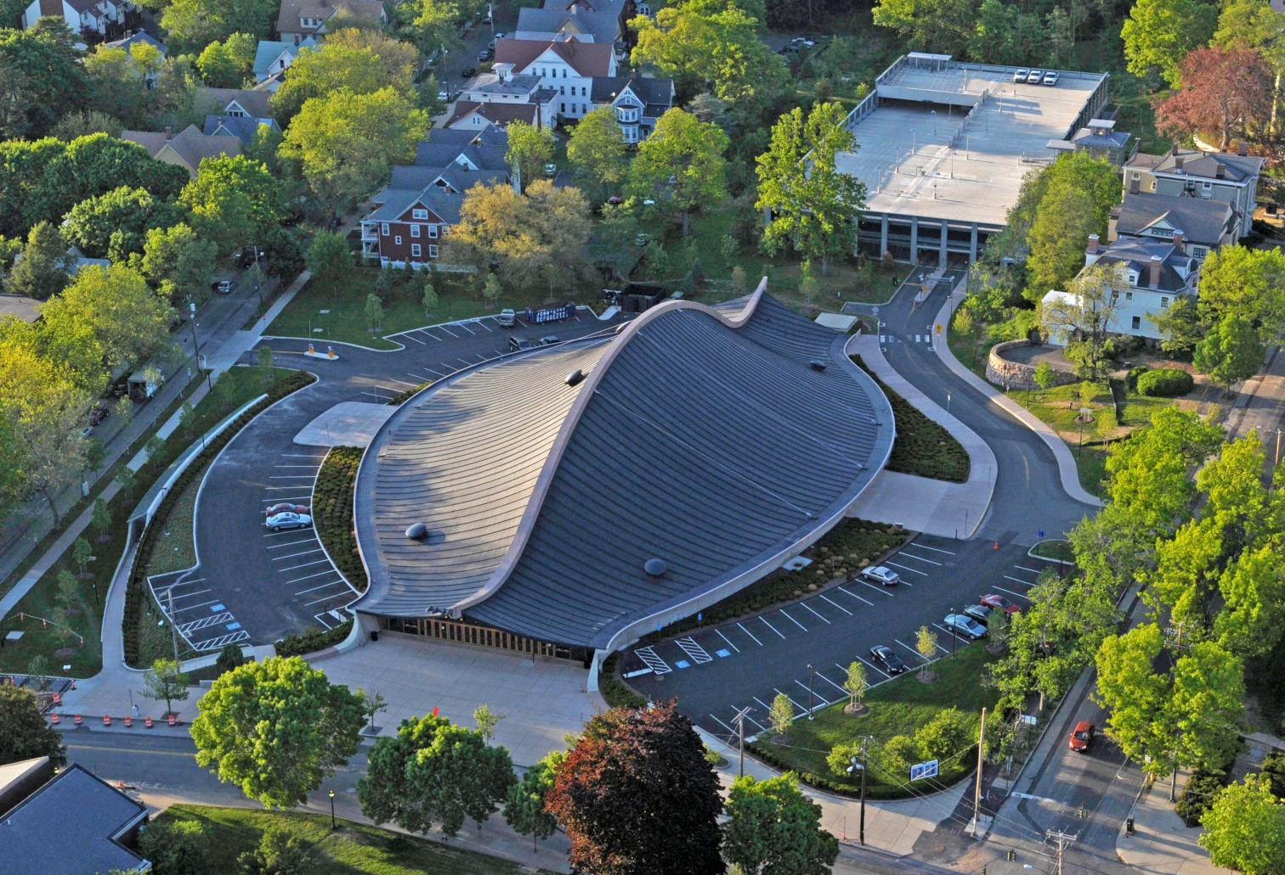
Project Overview
Scope + concept
LG | Building Exterior
Diving
LG | Circulation Corridor
Coral Reef
LG | Rink
Ocean
EL | branch circuit analysis
EL | copper vs. aluminum cost analysis
Acoustic | reverberation time analysis
Thanks to…

Slide 5
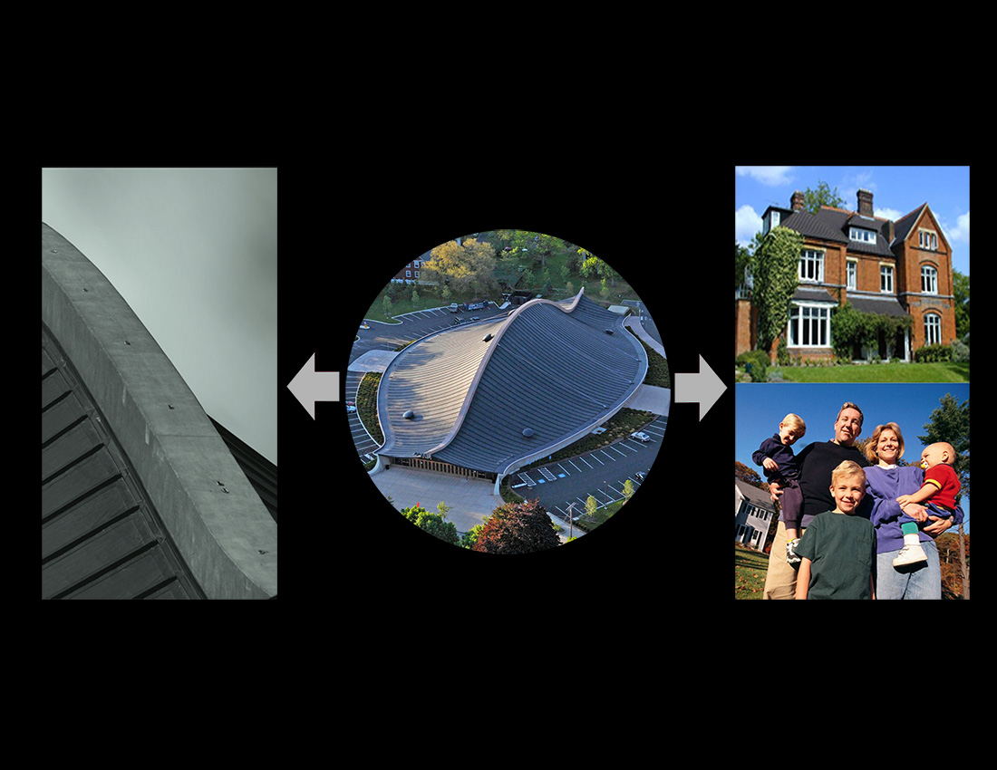
Project Overview
Scope + concept
LG | Building Exterior
Diving
LG | Circulation Corridor
Coral Reef
LG | Rink
Ocean
EL | branch circuit analysis
EL | copper vs. aluminum cost analysis
Acoustic | reverberation time analysis
Thanks to…

Slide 6
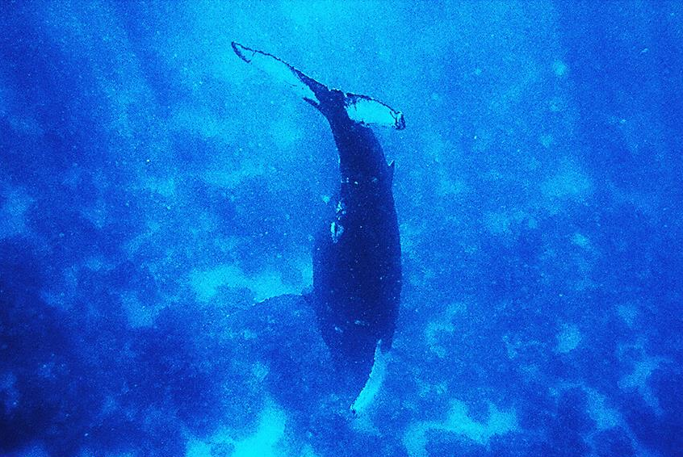
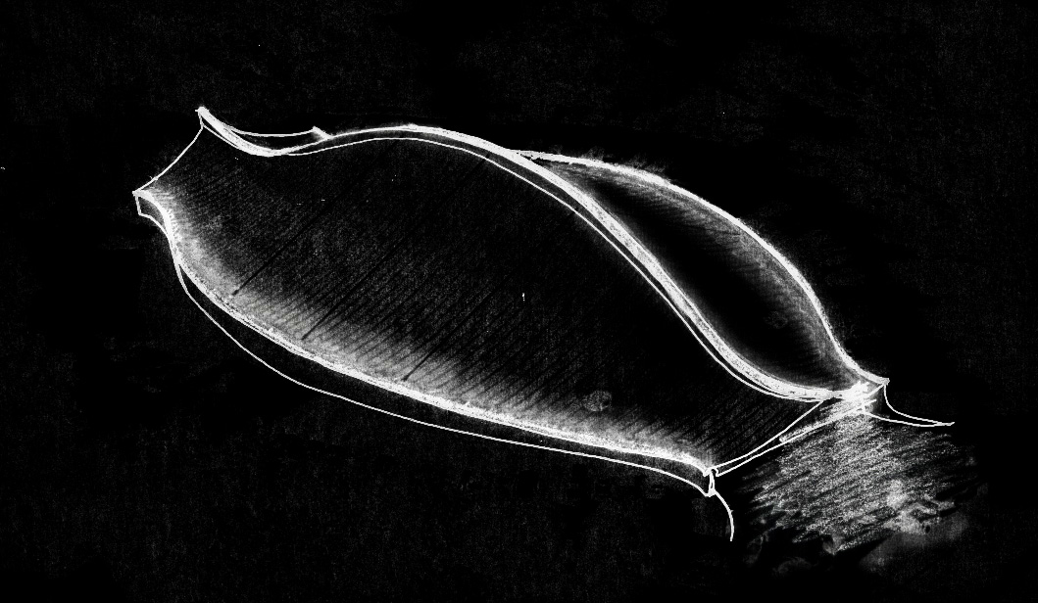
Project Overview
Scope + concept
LG | Building Exterior
Diving
LG | Circulation Corridor
Coral Reef
LG | Rink
Ocean
EL | branch circuit analysis
EL | copper vs. aluminum cost analysis
Acoustic | reverberation time analysis
Thanks to…

Slide 7
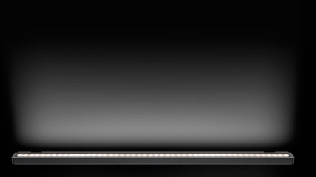
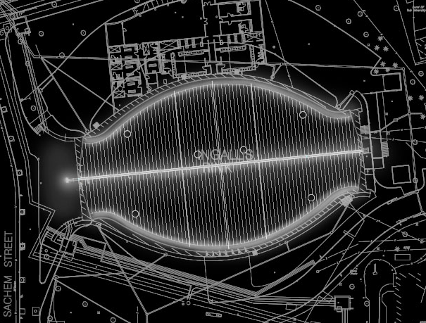
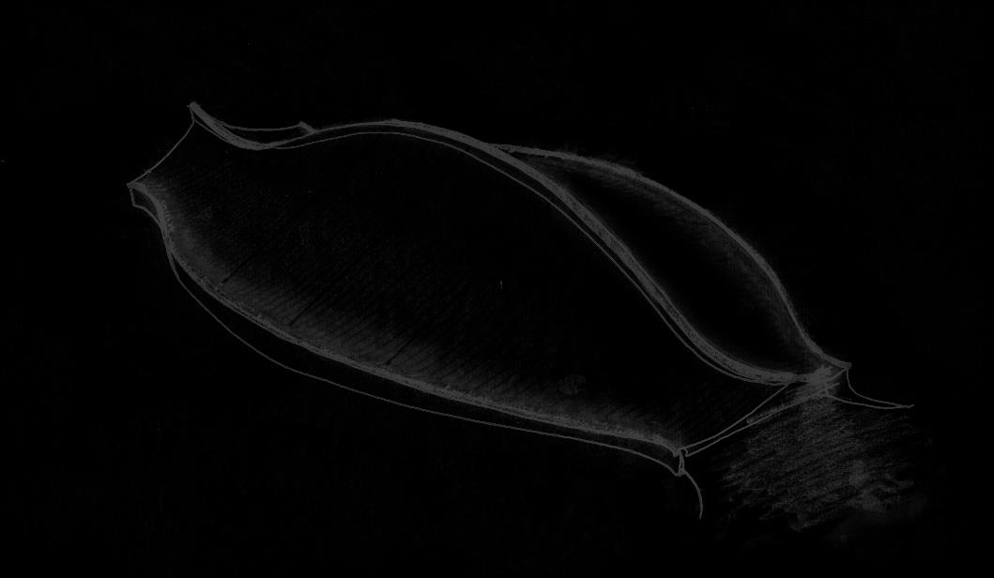
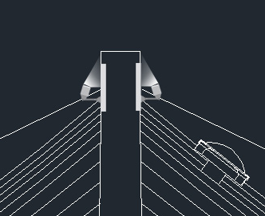
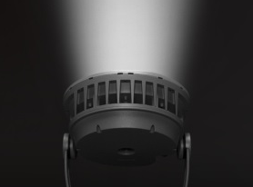
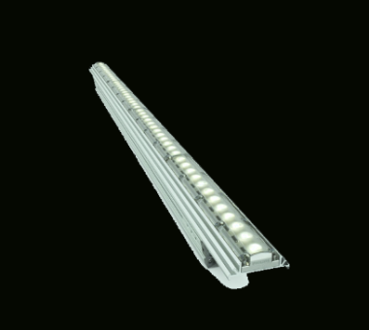
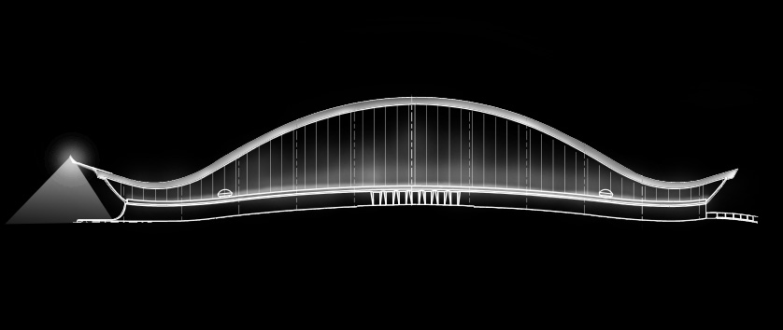
Project Overview
Scope + concept
LG | Building Exterior
Diving
LG | Circulation Corridor
Coral Reef
LG | Rink
Ocean
EL | branch circuit analysis
EL | copper vs. aluminum cost analysis
Acoustic | reverberation time analysis
Thanks to…
5w LED
linear grazer
adjustable 6” arm
100w LED
exterior downlight
surface
5w/10w/15w LED
linear flood light
surface

Slide 8
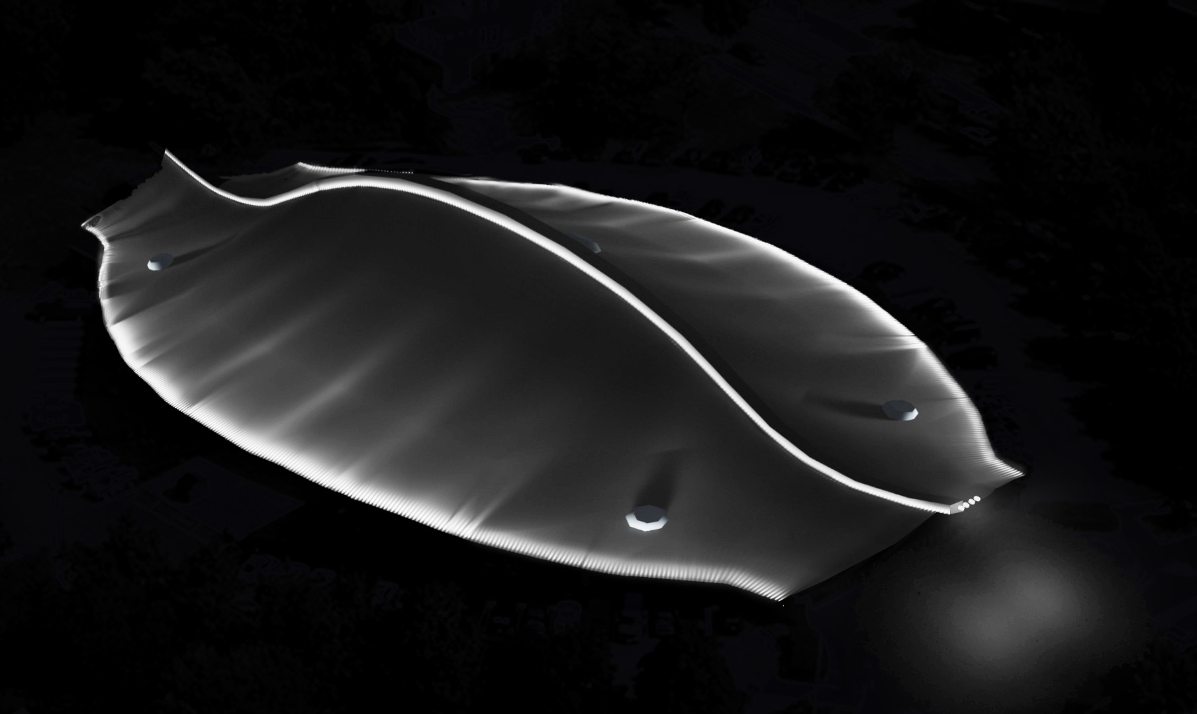
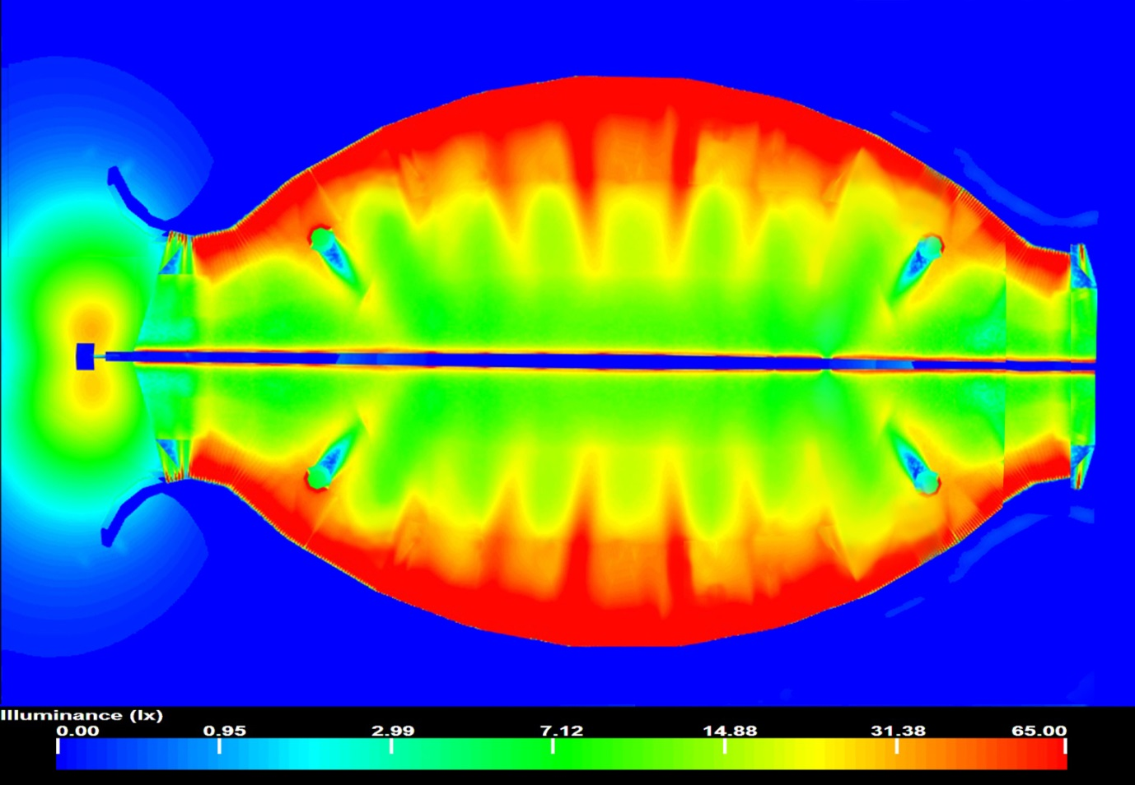
Project Overview
Scope + concept
LG | Building Exterior
Diving
LG | Circulation Corridor
Coral Reef
LG | Rink
Ocean
EL | branch circuit analysis
EL | copper vs. aluminum cost analysis
Acoustic | reverberation time analysis
Thanks to…
surface | illuminance (fc)
roof spine | 50
roof surface | 4
front plaza | 2.5
LPD | designed | allowable
exterior | 0.156 | 0.15
front Plaza | 0.06 | 0.16

Slide 9
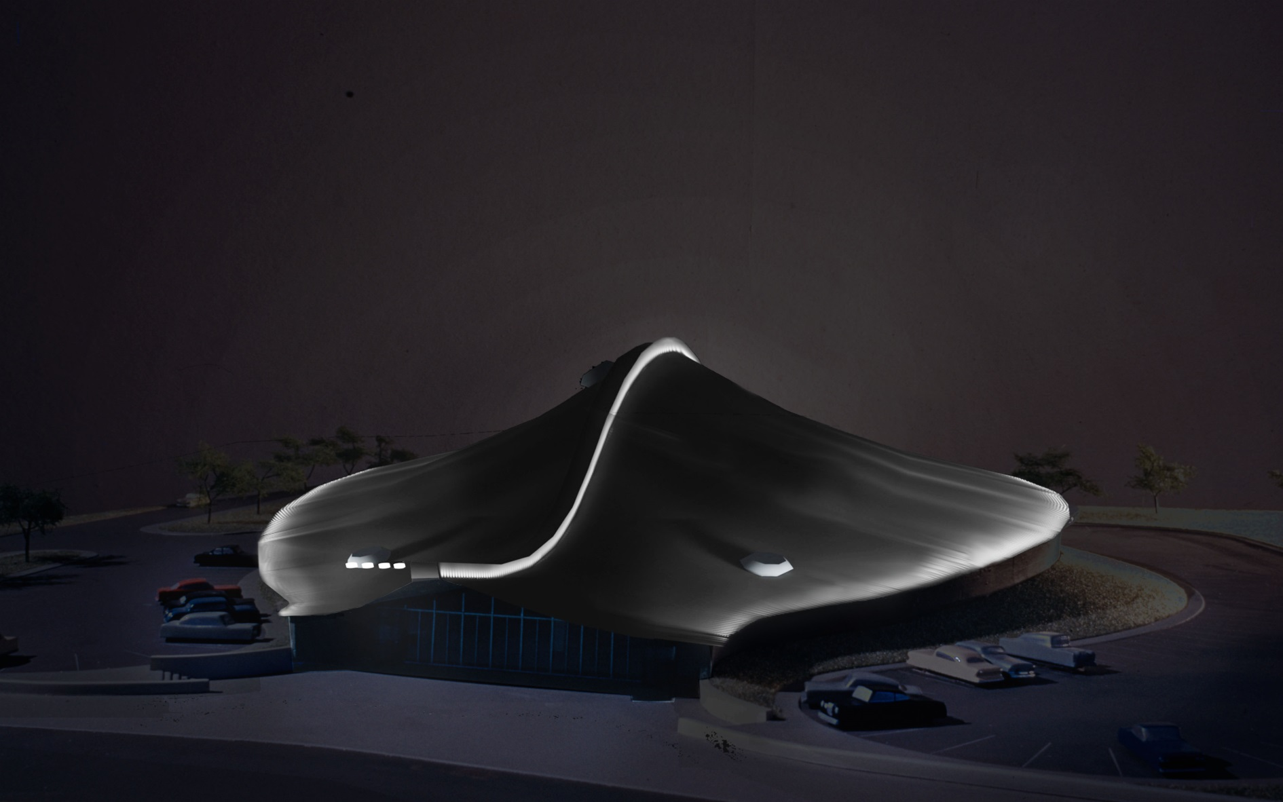
Project Overview
Scope + concept
LG | Building Exterior
Diving
LG | Circulation Corridor
Coral Reef
LG | Rink
Ocean
EL | branch circuit analysis
EL | copper vs. aluminum cost analysis
Acoustic | reverberation time analysis
Thanks to…
surface | illuminance (fc)
roof spine | 50
roof surface | 4
front plaza | 2.5
LPD | designed | allowable
exterior | 0.156 | 0.15
front Plaza | 0.06 | 0.16

Slide 10
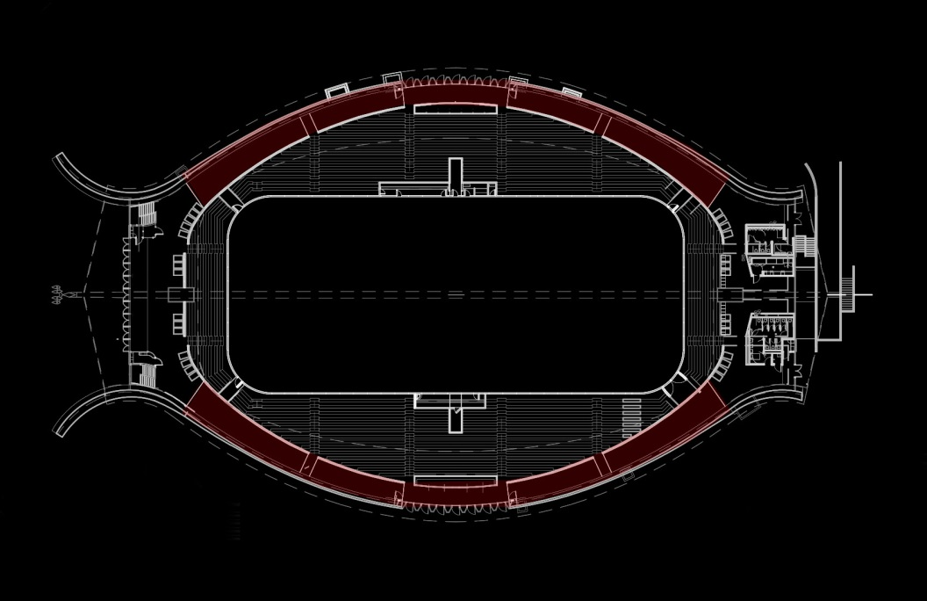
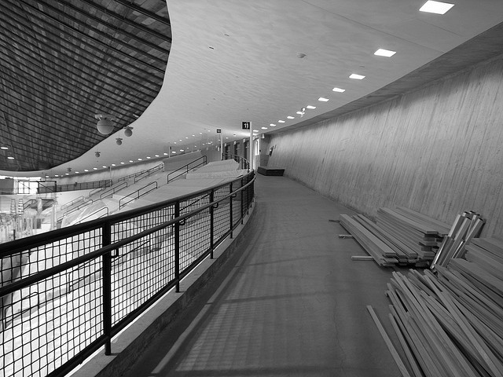
Project Overview
Scope + concept
LG | Building Exterior
Diving
LG | Circulation Corridor
Coral Reef
LG | Rink
Ocean
EL | branch circuit analysis
EL | copper vs. aluminum cost analysis
Acoustic | reverberation time analysis
Thanks to…

Slide 11
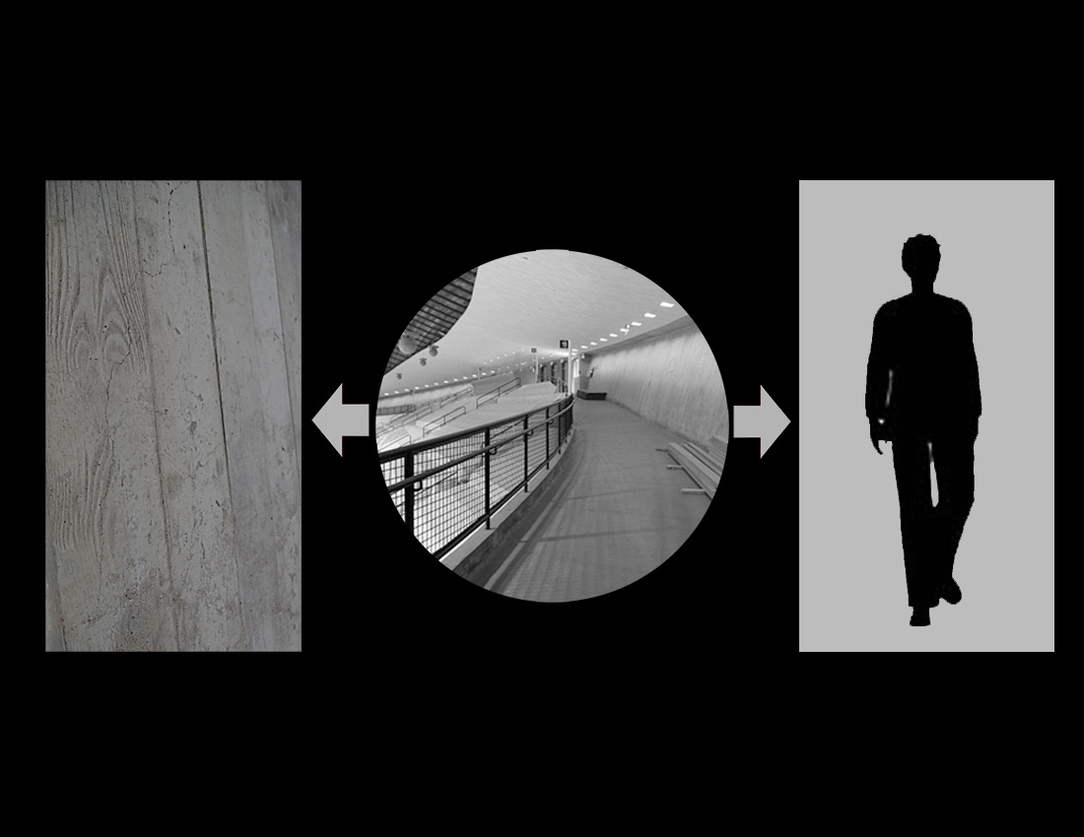
Project Overview
Scope + concept
LG | Building Exterior
Diving
LG | Circulation Corridor
Coral Reef
LG | Rink
Ocean
EL | branch circuit analysis
EL | copper vs. aluminum cost analysis
Acoustic | reverberation time analysis
Thanks to…

Slide 12
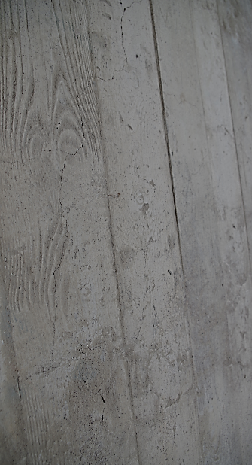
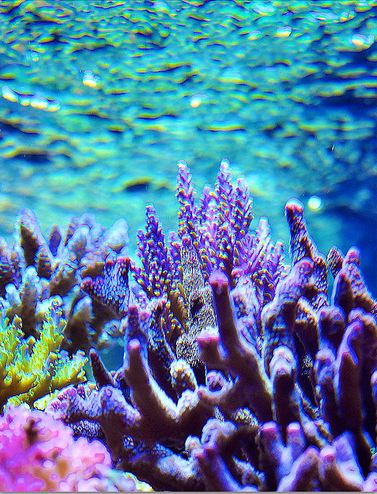
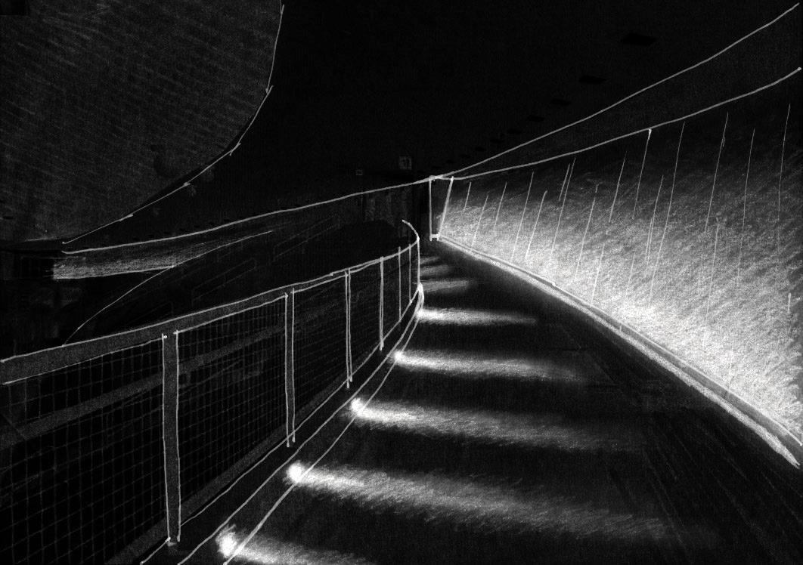
Project Overview
Scope + concept
LG | Building Exterior
Diving
LG | Circulation Corridor
Coral Reef
LG | Rink
Ocean
EL | branch circuit analysis
EL | copper vs. aluminum cost analysis
Acoustic | reverberation time analysis
Thanks to…

Slide 13
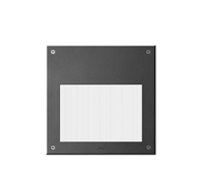
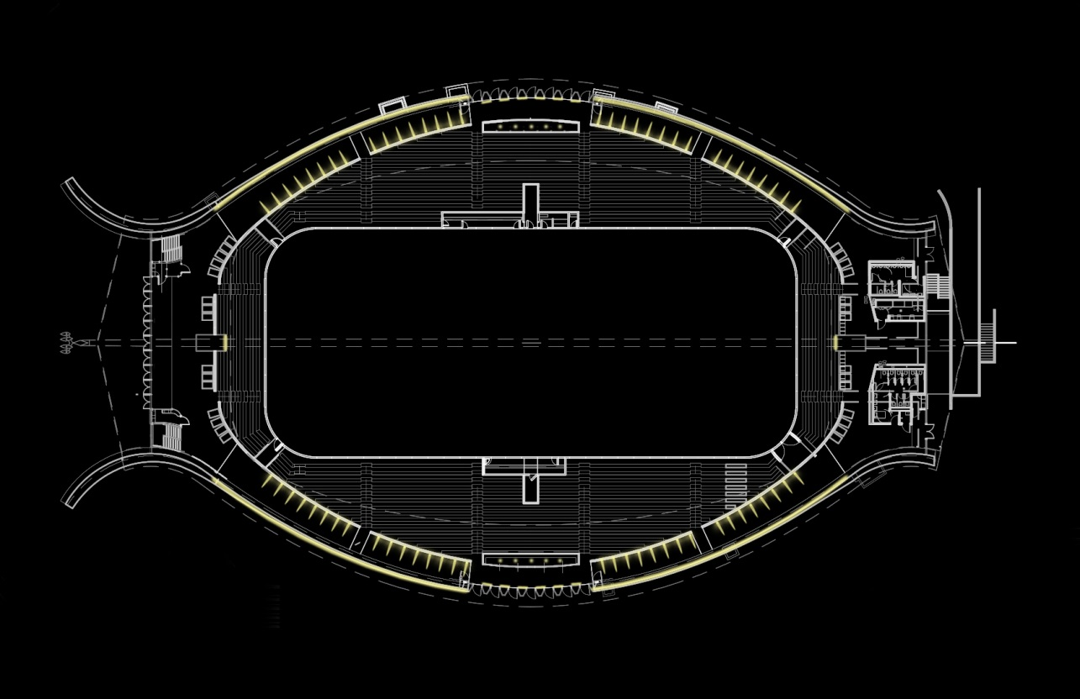
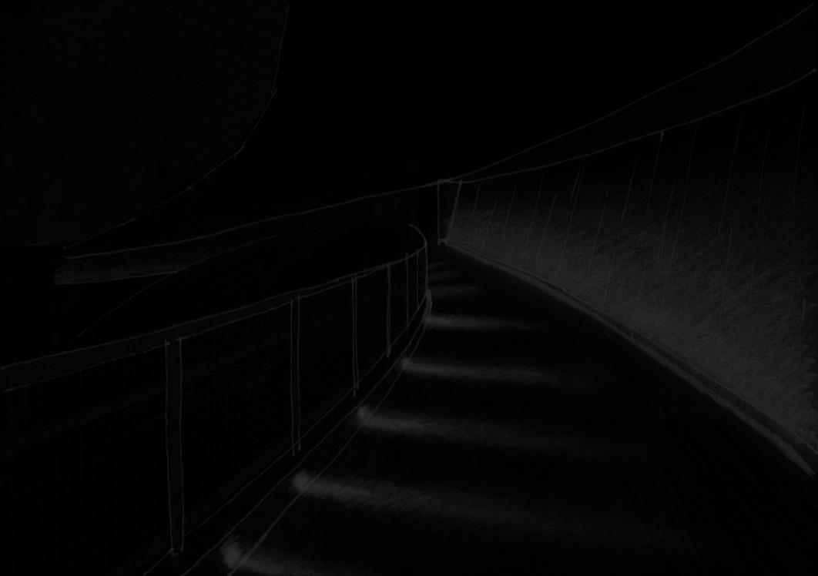
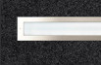
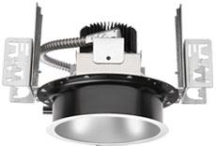
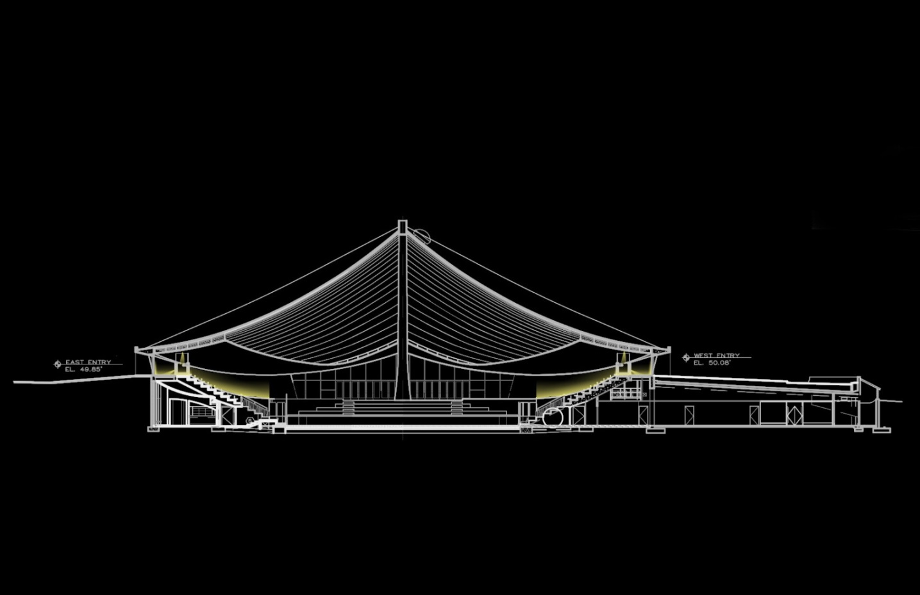
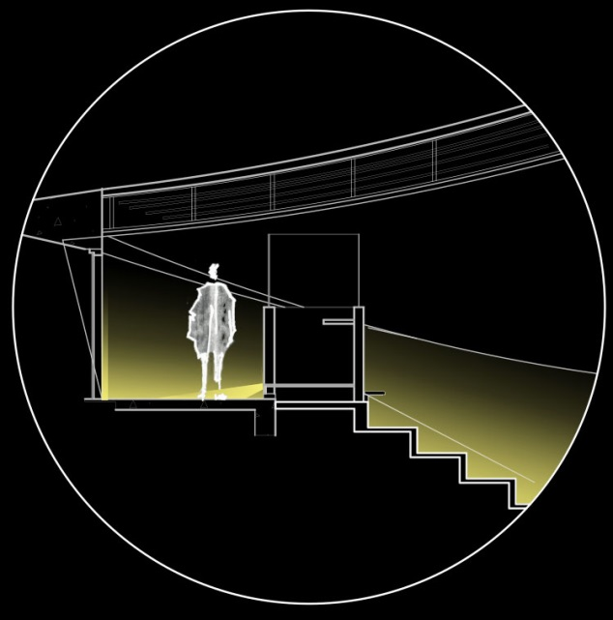
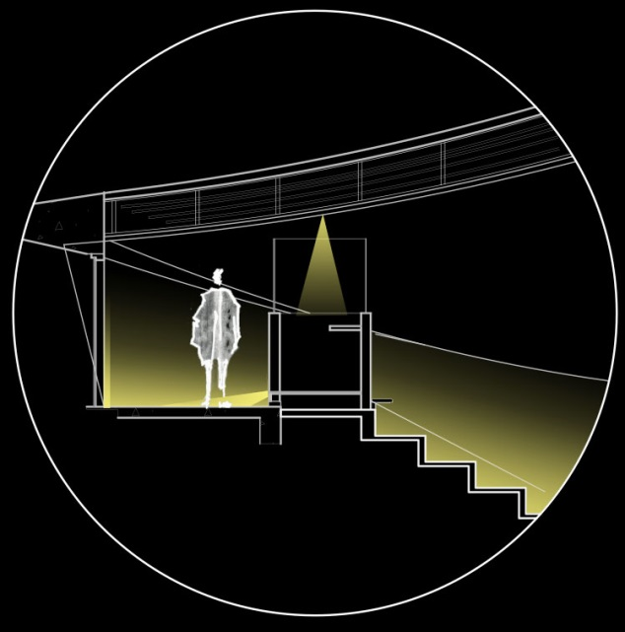
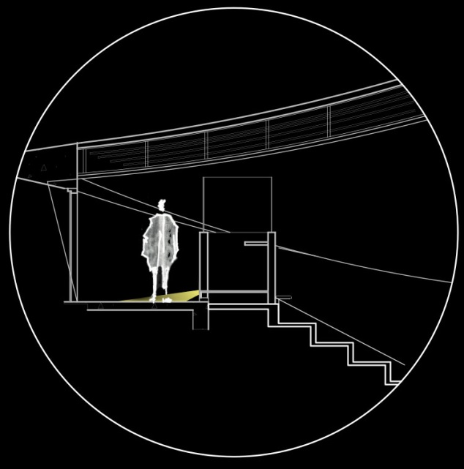
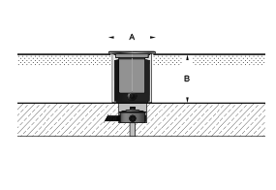
20w MH
adjustable optic steplight
recessed
Project Overview
Scope + concept
LG | Building Exterior
Diving
LG | Circulation Corridor
Coral Reef
LG | Rink
Ocean
EL | branch circuit analysis
EL | copper vs. aluminum cost analysis
Acoustic | reverberation time analysis
Thanks to…
22w LED
asymmetrical wallwasher
in-ground
18w LED
downlight
recessed

Slide 14
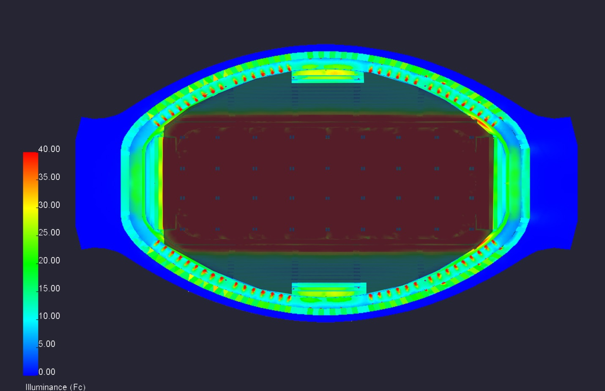
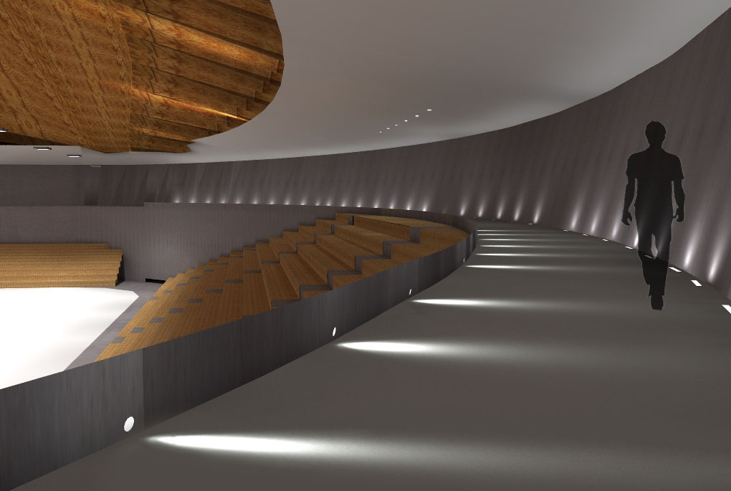
Project Overview
Scope + concept
LG | Building Exterior
Diving
LG | Circulation Corridor
Coral Reef
LG | Rink
Ocean
EL | branch circuit analysis
EL | copper vs. aluminum cost analysis
Acoustic | reverberation time analysis
Thanks to…
surface | illuminance (fc)
circulation floor | 28
circulation @ 6' | 11
wall | 17
press box | 29
seating | 19
LPD | designed | allowable
circulation | 0.44 | 0.66

Slide 15
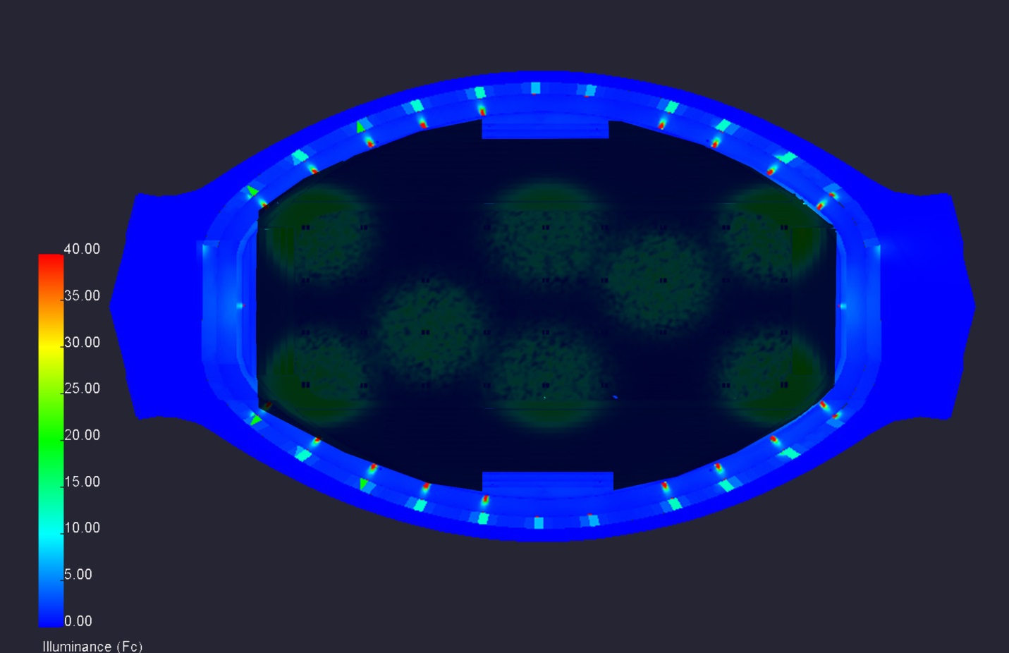
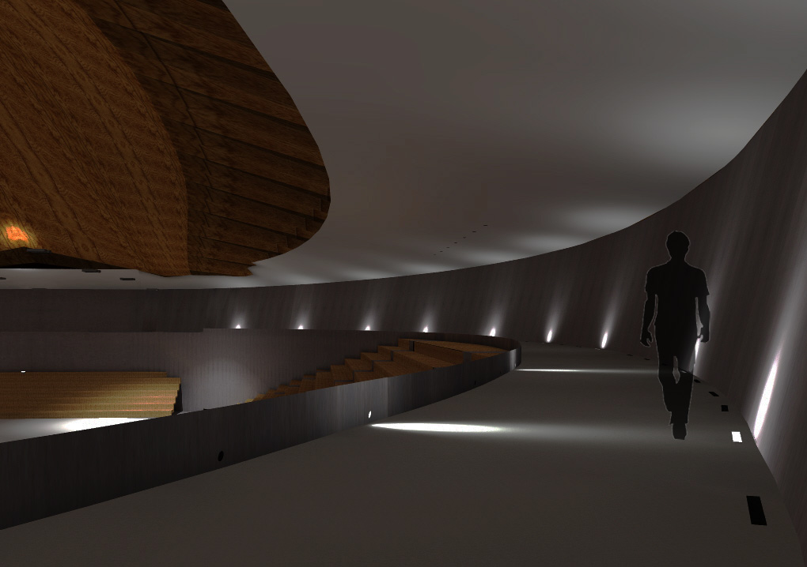
Project Overview
Scope + concept
LG | Building Exterior
Diving
LG | Circulation Corridor
Coral Reef
LG | Rink
Ocean
EL | branch circuit analysis
EL | copper vs. aluminum cost analysis
Acoustic | reverberation time analysis
Thanks to…
surface | illuminance (fc)
circulation floor | 9.5
circulation @ 6' | 2
wall | 1.5
press box | 1.5
seating | 3.56

Slide 16
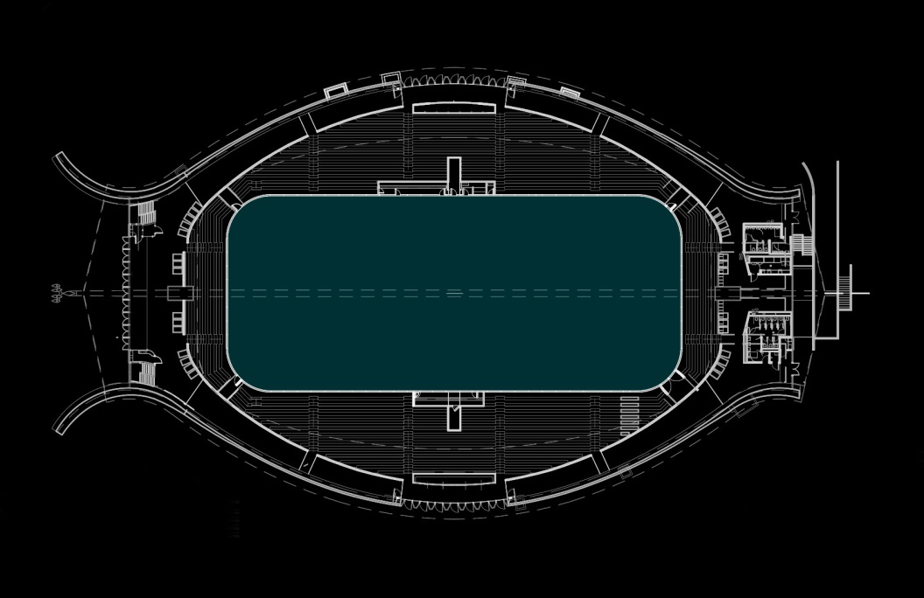
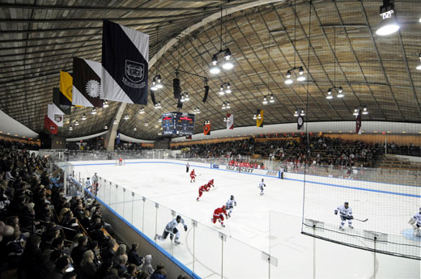
Project Overview
Scope + concept
LG | Building Exterior
Diving
LG | Circulation Corridor
Coral Reef
LG | Rink
Ocean
EL | branch circuit analysis
EL | copper vs. aluminum cost analysis
Acoustic | reverberation time analysis
Thanks to…

Slide 17
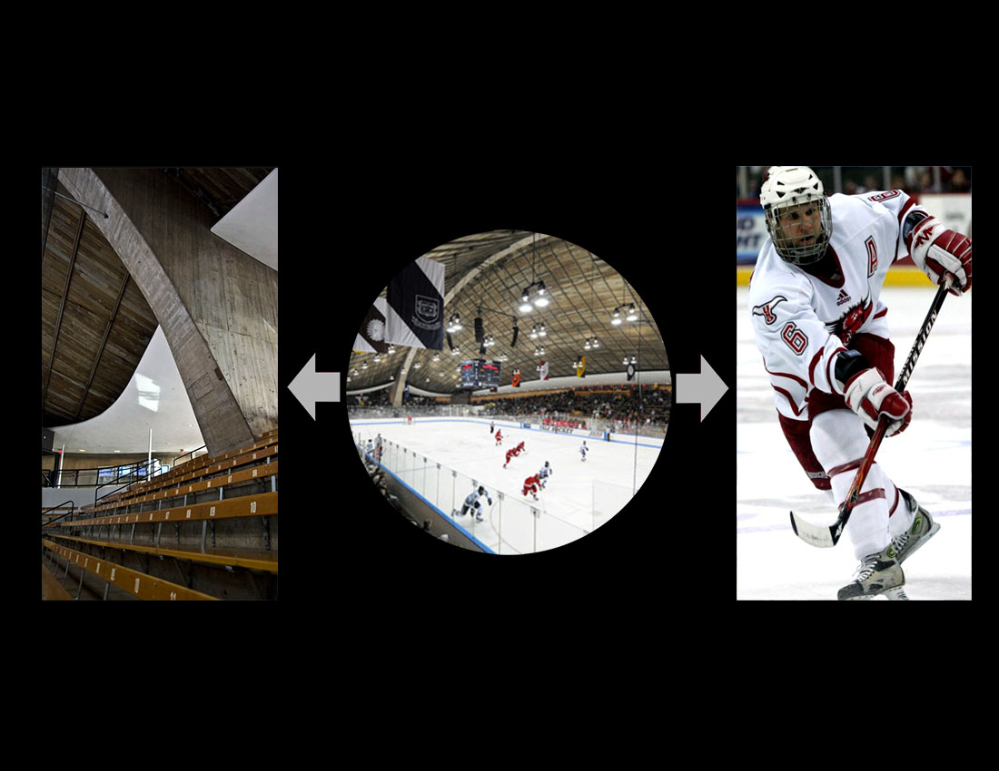
Project Overview
Scope + concept
LG | Building Exterior
Diving
LG | Circulation Corridor
Coral Reef
LG | Rink
Ocean
EL | branch circuit analysis
EL | copper vs. aluminum cost analysis
Acoustic | reverberation time analysis
Thanks to…

Slide 18
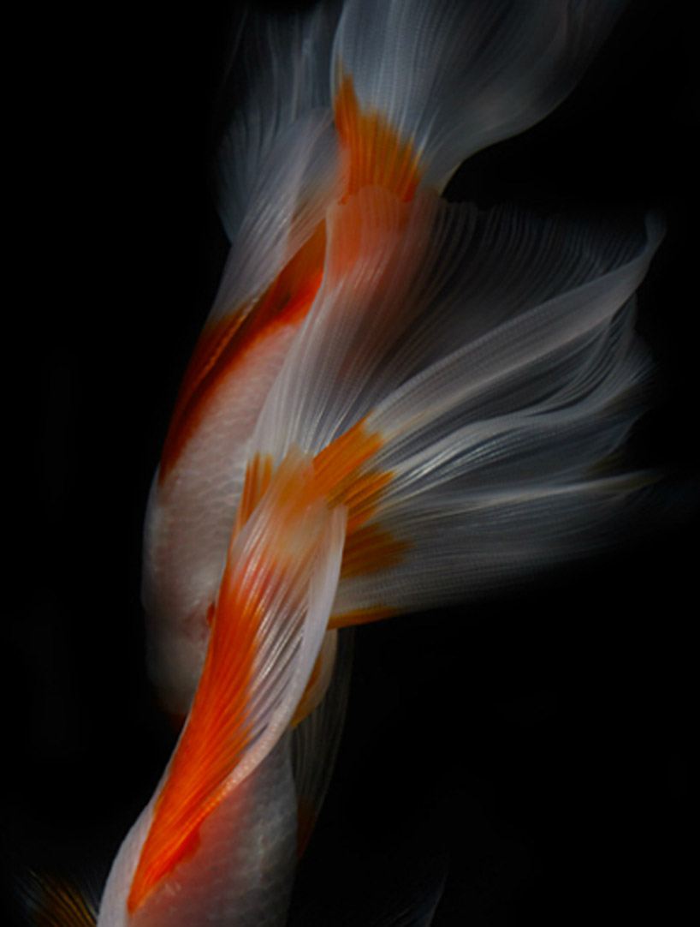
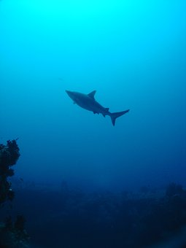
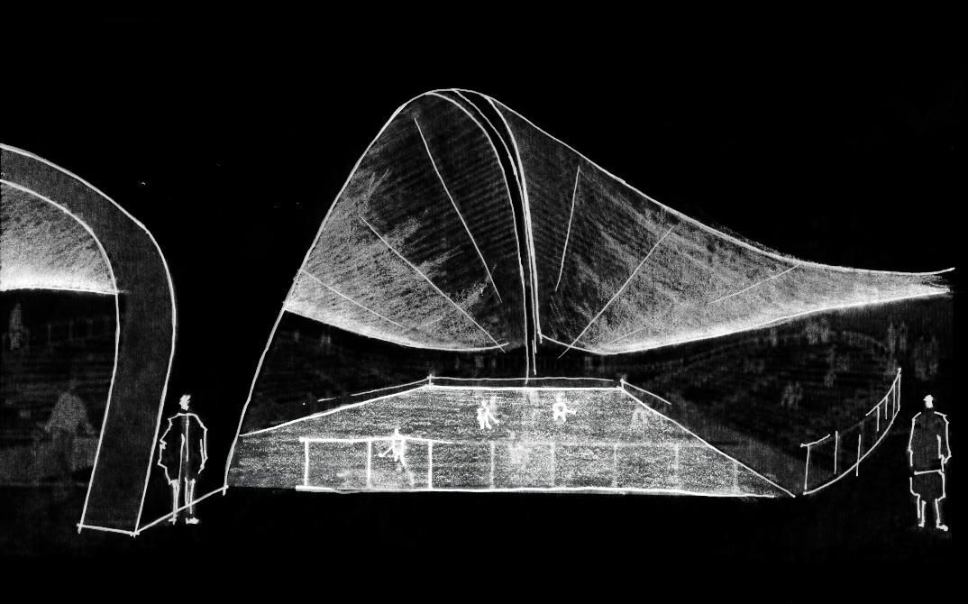
Project Overview
Scope + concept
LG | Building Exterior
Diving
LG | Circulation Corridor
Coral Reef
LG | Rink
Ocean
EL | branch circuit analysis
EL | copper vs. aluminum cost analysis
Acoustic | reverberation time analysis
Thanks to…

Slide 19
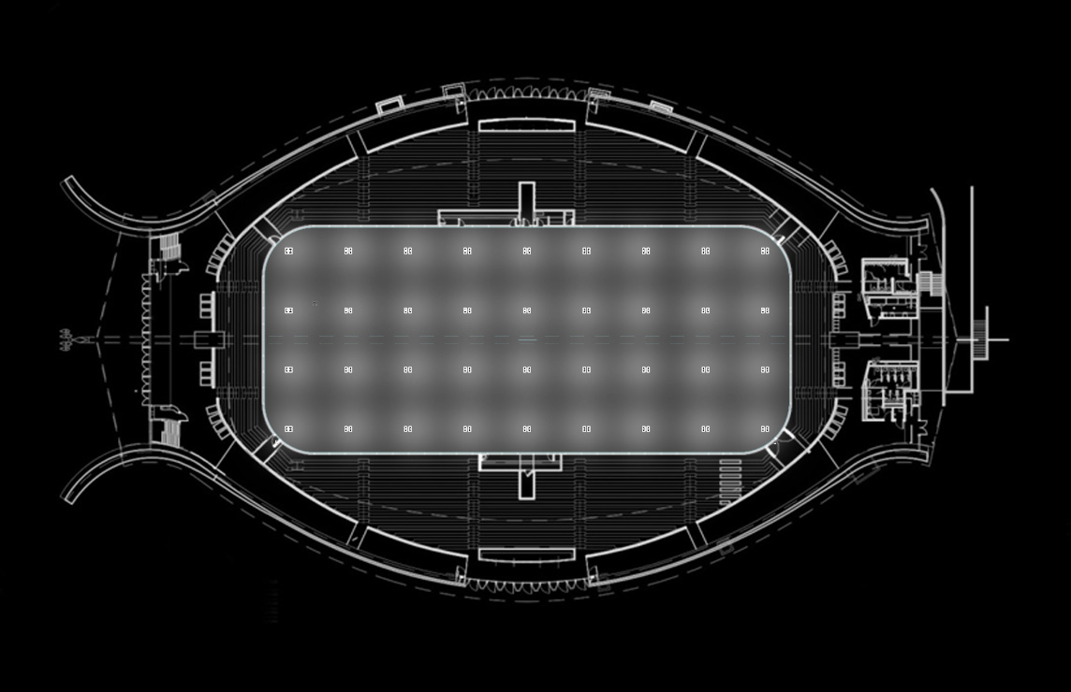
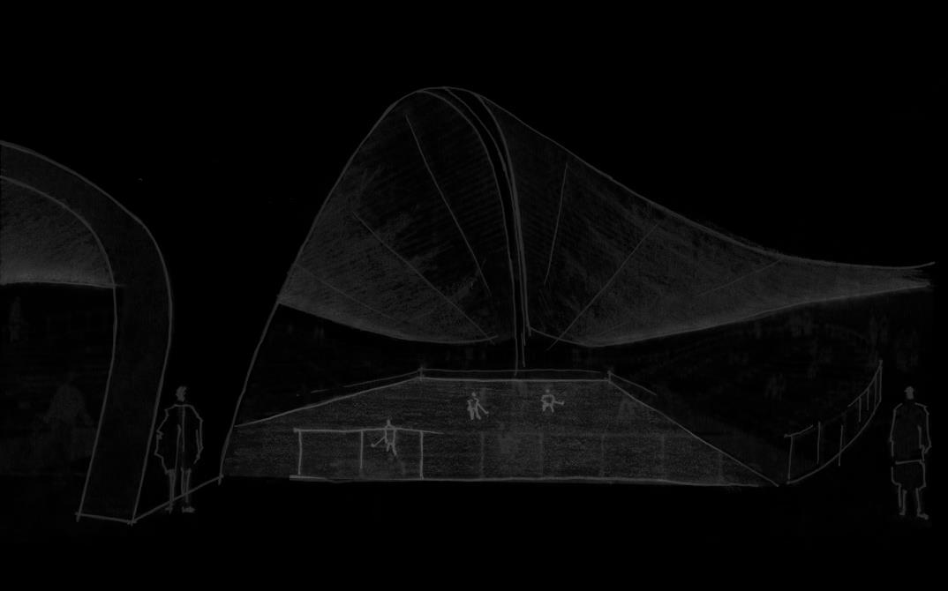
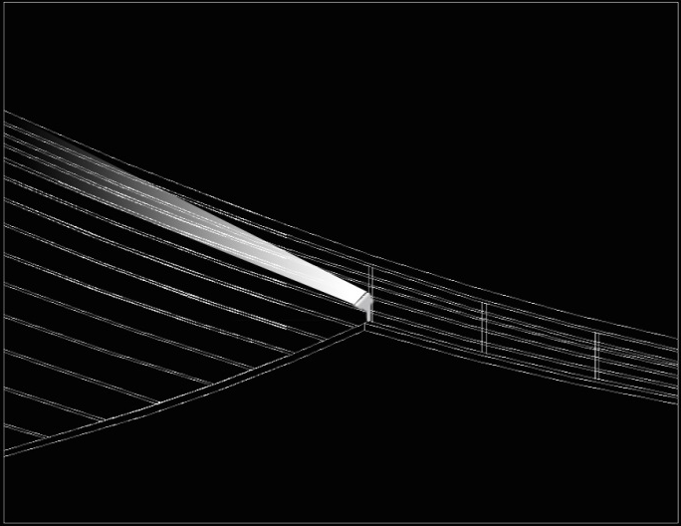
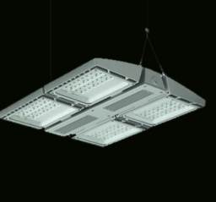
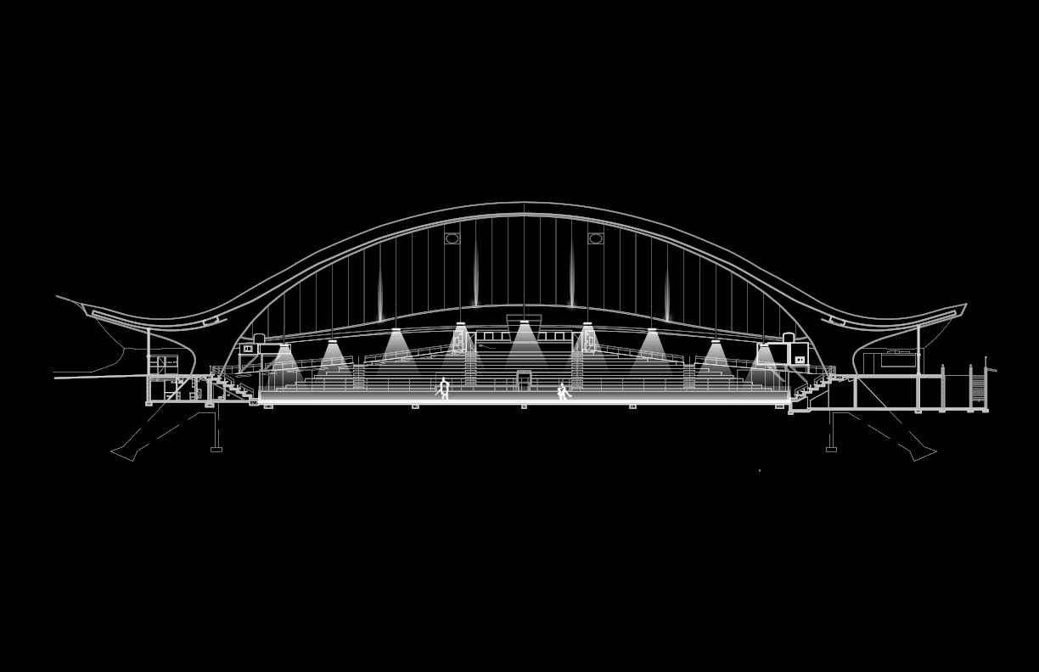
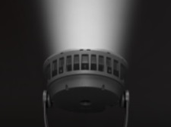
Project Overview
Scope + concept
LG | Building Exterior
Diving
LG | Circulation Corridor
Coral Reef
LG | Rink
Ocean
EL | branch circuit analysis
EL | copper vs. aluminum cost analysis
Acoustic | reverberation time analysis
Thanks to…
267w LED
highbay downlight
pendant
50w LED
floodlight
surface

Slide 20


Project Overview
Scope + concept
LG | Building Exterior
Diving
LG | Circulation Corridor
Coral Reef
LG | Rink
Ocean
EL | branch circuit analysis
EL | copper vs. aluminum cost analysis
Acoustic | reverberation time analysis
Thanks to…
surface | illuminance (fc)
rink @ 3.5’ | 95
ceiling | 20
seating | 18
LPD | designed | allowable
rink | 1.16 | 1.92

Slide 21

Project Overview
Scope + concept
LG | Building Exterior
Diving
LG | Circulation Corridor
Coral Reef
LG | Rink
Ocean
EL | branch circuit analysis
EL | copper vs. aluminum cost analysis
Acoustic | reverberation time analysis
Thanks to…

Slide 22





Project Overview
Scope + concept
LG | Building Exterior
Diving
LG | Circulation Corridor
Coral Reef
LG | Rink
Ocean
EL | branch circuit analysis
EL | copper vs. aluminum cost analysis
Acoustic | reverberation time analysis
Thanks to…
chain motor
moving/profile
theater fixture

Slide 23
Project Overview
Scope + concept
LG | Building Exterior
Diving
LG | Circulation Corridor
Coral Reef
LG| Rink
Ocean
EL | branch circuit analysis
EL | copper vs. aluminum cost analysis
Acoustic | reverberation time analysis
Thanks to…
Annual Savings: 34,776 KWh
Type | Location | Lamps | #of fixtures | Total KVA
A01 | Rink | (1) 400W PS MH | 72 | 28.8
A02 | Circulation Corridoor | (1) 32W TTT (830) | 82 | 2.624
A03 | Circulation Corridoor | (1) 32W TTT (830) | 48 | 1.536
A10 | Schley Club Room | (1) 26W Quad Tube (835) | 12 | 0.312
A11 | Schley Club Room | 75 W PAR 30 flood | 24 | 1.8
A12 | Schley Club Room | (1) 28W T5 (835) | 36 | 1.008
A24 | Schley Club Room | (1) 26W TTT (830) | 4 | 0.104
 |  |  | Total | 36.184
Type | Location | Lamps | #of fixtures | Total KVA
AD01 | Pressbox, Schley Club Room | 13W LED | 42 | 0.546
AD02 | Schley Club Room | 11W LED | 15 | 0.165
AF01 | Rink | 50W LED | 10 | 0.5
AG01 | Schley Club Room | 24W LED | 19 | 0.456
AG01(a) | Schley Club Room | 6W LED | 1 | 0.006
AP01 | Rink | 267W LED | 72 | 19.224
AS01 | Circulation Corridoor | 20W MH | 70 | 1.4
AW01 | Circulation Corridoor | 27W LED | 85 | 2.295
 |  |  | Total | 24.592

Slide 24
Project Overview
Scope + concept
LG | Building Exterior
Diving
LG | Circulation Corridor
Coral Reef
LG| Rink
Ocean
EL | branch circuit analysis
EL | copper vs. aluminum cost analysis
Acoustic | reverberation time analysis
Thanks to…
Copper
Copper | $273,612.30
Aluminum | $206,852.20
Savings | $66,760.10
Aluminum

Slide 25




Project Overview
Scope + concept
LG | Building Exterior
Diving
LG | Circulation Corridor
Coral Reef
LG| Rink
Ocean
EL | branch circuit analysis
EL | copper vs. aluminum cost analysis
Acoustic | reverberation time analysis
Thanks to…

Slide 26

Project Overview
Scope + concept
LG | Building Exterior
Diving
LG | Circulation Corridor
Coral Reef
LG| Rink
Ocean
EL | branch circuit analysis
EL | copper vs. aluminum cost analysis
Acoustic | reverberation time analysis
Thanks to…
RT₅₀₀ = 7.15s

Slide 27
Project Overview
Scope + concept
LG | Building Exterior
Diving
LG | Circulation Corridor
Coral Reef
LG| Rink
Ocean
EL | branch circuit analysis
EL | copper vs. aluminum cost analysis
Acoustic | reverberation time analysis
Thanks to…
RT₅₀₀ = 1.61s

Slide 28
Project Overview
Scope + concept
LG | Building Exterior
Diving
LG | Circulation Corridor
Coral Reef
LG| Rink
Ocean
EL | branch circuit analysis
EL | copper vs. aluminum cost analysis
Acoustic | reverberation time analysis
Thanks to…

Slide 29
Project Overview
Scope + concept
LG | Building Exterior
Diving
LG | Circulation Corridor
Coral Reef
LG| Rink
Ocean
EL | branch circuit analysis
EL | copper vs. aluminum cost analysis
Acoustic | reverberation time analysis
Thanks to…
Thanks to...
Dr. Kevin Houser
Dr. Richard Mistrick
Professor Shawn Good
Professor Leslie Beahm
Professor Kevin Parfitt
Dr. Ryan Solnosky
Professor Paul Kremer
Professor William Kenyon
Mark Loeffler, Atelier Ten
Chad Groshart, Atelier Ten
Gus Sanchez, Atelier Ten
Sarah Fisher, Atelier Ten
Alice Raucher, Yale University
Friends & Family
All fellow AEs

Slide 30
Appendix

Slide 31







Slide 32



Slide 33



